Slide 1
Linear Regression

Slide 2
Outline
What is Linear Regression?
Modeling Linear Regression
Motivation: Why Linear Regression is important
In Class Projects

Slide 3
Example
A research project investigated text entry on soft keyboards
The research also asked…
Can stylus tapping entry speed be predicted from touch typing entry speed?
Touch typing speed is the predictor variable (x - measured in a pre-test)
Stylus typing speed is the criterion variable (y - measured experimentally)
Data and scatter plot

Slide 4
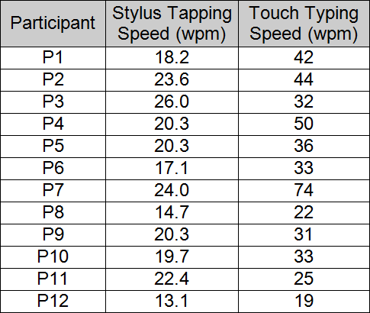
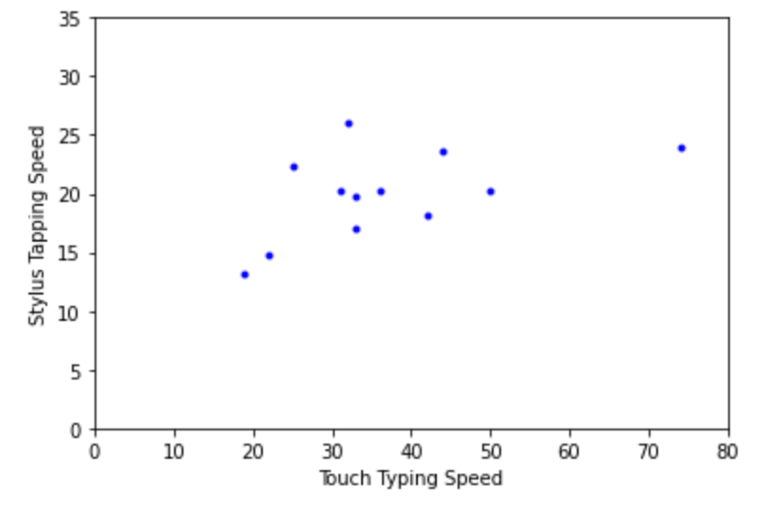
Linear Regression
There seems to be a relationship: Faster touch typists seem to be faster at stylus tapping.
Questions:
What is the prediction equation?
How strong is the relationship?

Slide 5
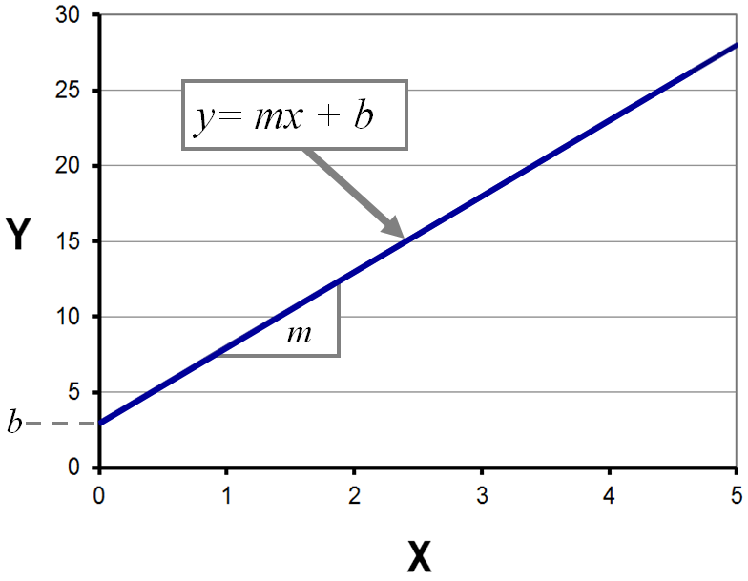
Linear Regression
The basic prediction equation expresses a linear relationship between a predictor variable (x) and a criterion variable (y):
Notes:
A linear prediction equation is built using a statistical procedure know as linear regression
Goal:
Given a set of x-y sample points, find the coefficients m and b for the line that minimizes the squared distances (least squares) of the points from the line
The result is a prediction equation that gives the best estimate of y in terms of x

Slide 6
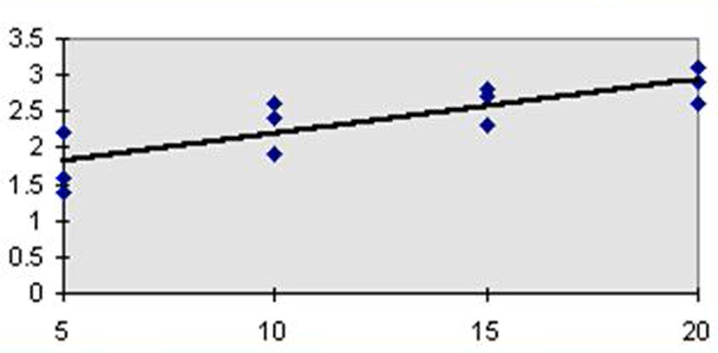
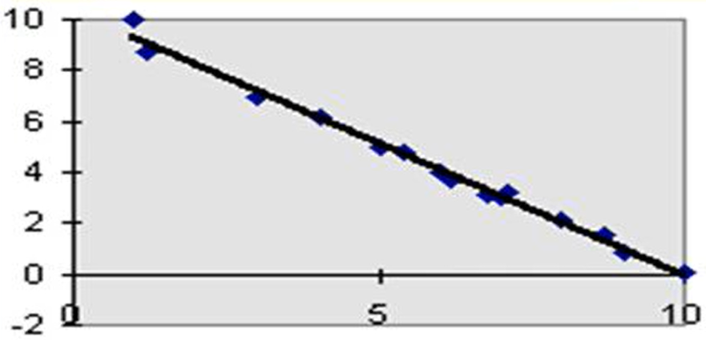
Linear Regression Types
x: input variable
y: output (target)
Positive Linear Relationship
Negative Linear Relationship
y
y
x
x

Slide 7
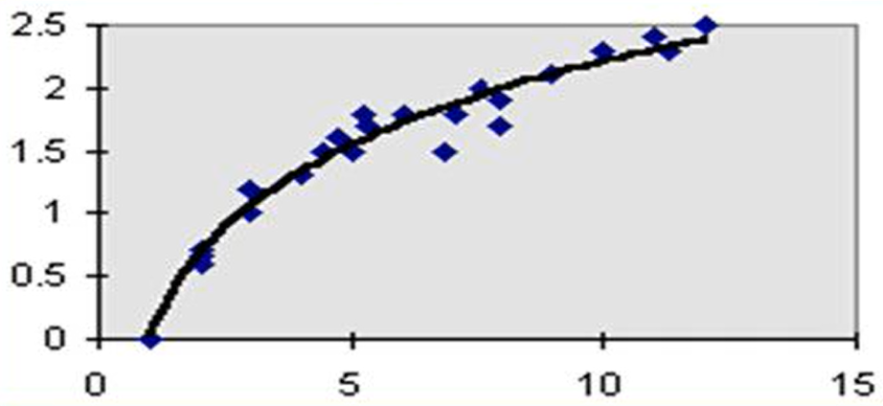
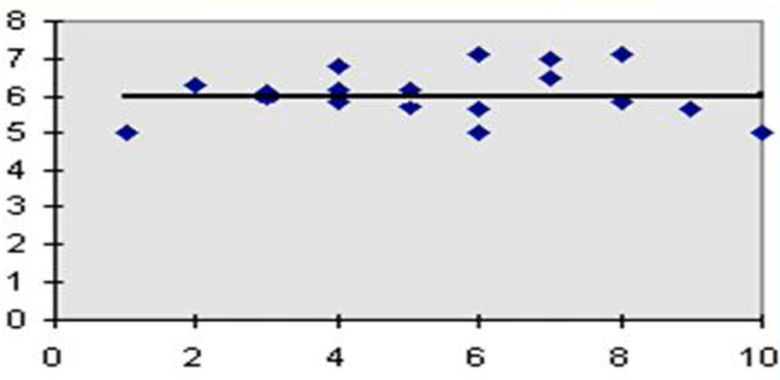
None-Linear Regression Types
x: input variable
y: output (target)
No – Linear Relationship
No - Relationship
y
y
x
x

Slide 8



Solution-Example
m
x =$\frac{1}{n}\sum_{i=1}^{n}{x_{i}}$ =36.75
y = $\frac{1}{n}\sum_{i=1}^{n}{y_{i}}$ =19.97
m = 0.135
b$=\overline{y}−m\overline{x}=19.97−0.135 ∗36.75=15.016$
18.2
23.6
26.0
20.3
20.3
17.1
24.0
14.7
20.3
19.7
22.4
13.1
42
44
32
50
36
33
74
22
31
33
25
19
y =
x =
average of x
Intercept
average of y
slope
n =12 (no. of participants)
Linear Regression Model: y = b + mx ====> y = 15.016 + 0.135x

Slide 9
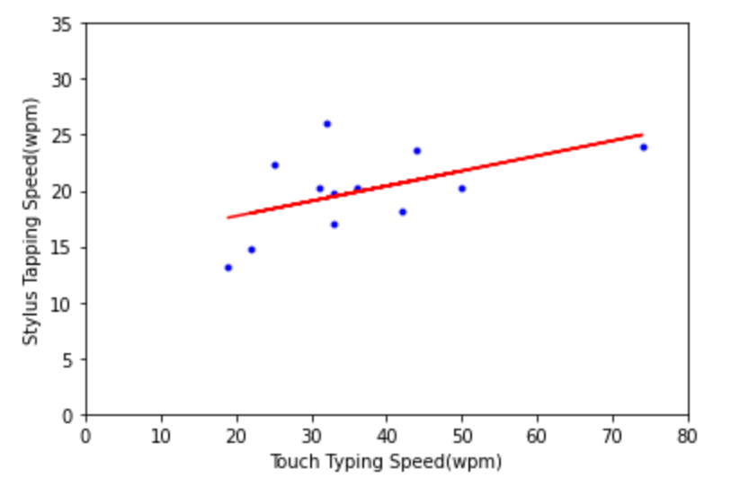
Prediction Equation
Linear Regression Model: y = a + bx ====> y = 15.037 + 0.134x
Notes:
y is called the dependent variable.
x is called the independent variable.

Slide 10
Motivation: Why Linear Regression is Important?
Linear Regression is used for :
1. Predictive Modeling
Can we predict Stylus tapping entry speed from touch typing entry speed ?
2. Forecasting, Time Series Modeling
What is the sales of a product in future months ?
3. Medicine
Does blood pressure affect heart diseases ?

Slide 11
In Class Project 1
Home Prices In Finland
Area (square feet) | Price (Euros)
2600 | 550000
3000 | 565000
3200 | 610000
3600 | 680000
4000 | 725000
Given these home prices,
find out home prices of
whose are are :
3300 square feet
5000 square feet

Slide 12
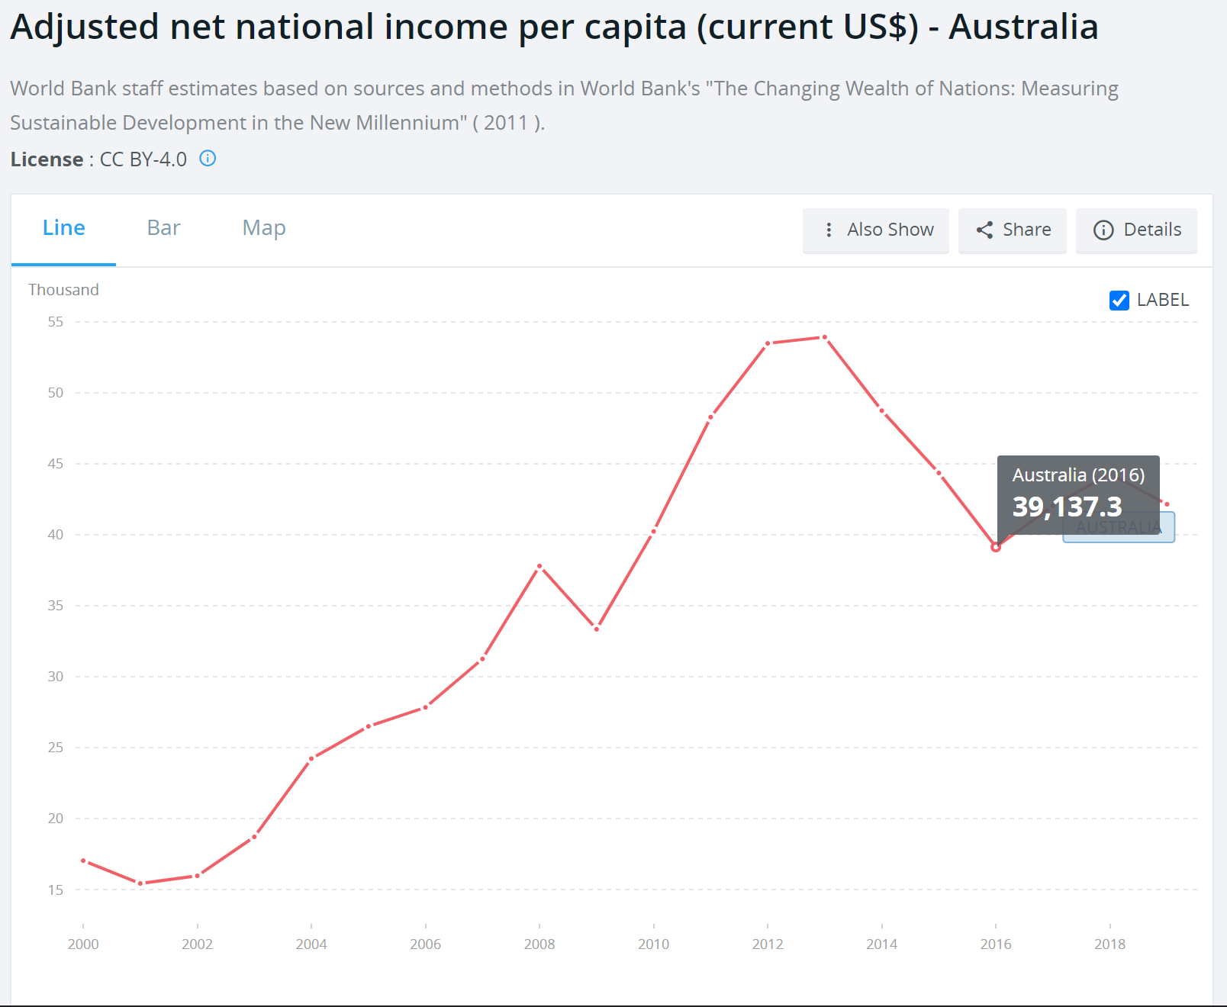
In Class Project 2
Given these income per capita
according to years, find the per capita
income of Australia in years :
2023
2030
https://data.worldbank.org/indicator/NY.ADJ.NNTY.PC.CD?locations=AU

Slide 13
References
MacKenzie, I. S., & Zhang, S. X. (2001). An empirical investigation of the novice experience with soft keyboards. Behaviour & Information Technology, 20, 411-418.
Flach, P. (2012). Machine Learning: The Art and Science of Algorithms that Make Sense of Data. Cambridge University Press.

